Slide 1
Reducing Cache Misses by More Flexible Placement of Blocks
CSE-3109 Computer Architecture
Lecture 12

Slide 2
Handling Cache Misses
So far, when we place a block in the cache, we have used a simple placement scheme: A block can go in exactly one place in the cache.
It is called direct mapped because there is a direct mapping from any block address in memory to a single location in the upper level of the hierarchy.

Slide 3
Handling Cache Misses
Direct mapped, where a block can be placed in exactly one location, is at one extreme.
At the other extreme is a scheme where a block can be placed in any location in the cache. Such a scheme is called fully associative, because a block in memory may be associated with any entry in the cache.

Slide 4
Fully associative cache
A fully associative cache permits data to be stored in any cache block, instead of forcing each memory address into one particular block.
When data is fetched from memory, it can be placed in any unused block of the cache.
This way we’ll never have a conflict between two or more memory addresses which map to a single cache block.

Slide 5
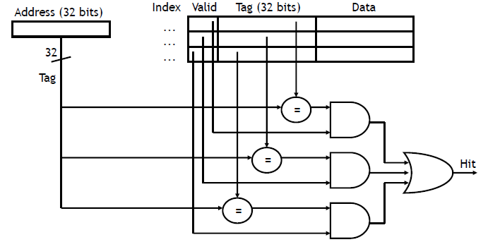
Fully associative cache
To find a given block in a fully associative cache, all the entries in the cache must be searched because a block can be placed in any one.
To make the search practical, it is done in parallel with a comparator associated with each cache entry.

Slide 6
The price of Fully associative cache
However, a fully associative cache is expensive to implement.
Data could be anywhere in the cache, so we must check the tag of every cache block. That’s a lot of comparators!
These comparators significantly increase the hardware cost, effectively making fully associative placement practical only for caches with small numbers of blocks.

Slide 7
Set associative cache
The middle range of designs between direct mapped and fully associative is called set associative.
The cache is divided into groups of blocks, called sets.
Each memory address maps to exactly one set in the cache, but data may be placed in any block within that set.
If each set has 2^{x} blocks, the cache is an 2^{x}-way associative cache.

Slide 8
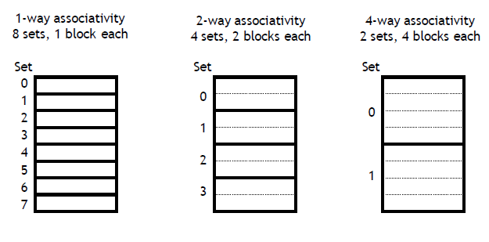
Set associative cache-Cont.
Each block in the memory maps to a unique set in the cache given by the index field, and a block can be placed in any element of that set.
Thus, a set-associative placement combines direct-mapped placement and fully associative placement: a block is directly mapped into a set, and then all the blocks in the set are searched for a match.

Slide 9
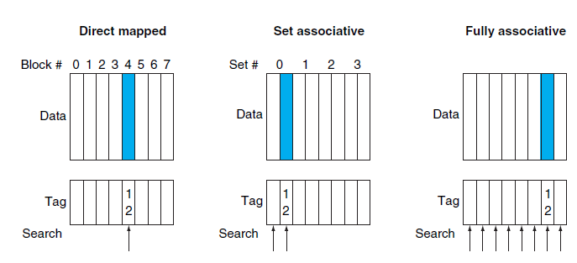
Set associative cache-Example
The location of a memory block whose address is 12 in a cache with eight blocks varies for direct mapped, set-associative, and fully associative placement. In direct-mapped placement, there is only one cache block where memory block 12 can be found, and that block is given by (12 modulo 8) = 4. In a two-way set-associative cache, there would be four sets, and memory block 12 must be in set (12 mod 4) = 0; the memory block could be in either element of the set. In a fully associative placement, the memory block for block address 12 can appear in any of the eight cache blocks.

Slide 10
Set associative cache
In a direct-mapped cache, the position of a memory block is given by,
(Block number) modulo (Number of blocks in the cache) (Slide 10)
In a set-associative cache, the set containing a memory block is given by,
(Block number) modulo (Number of sets in the cache)

Slide 11
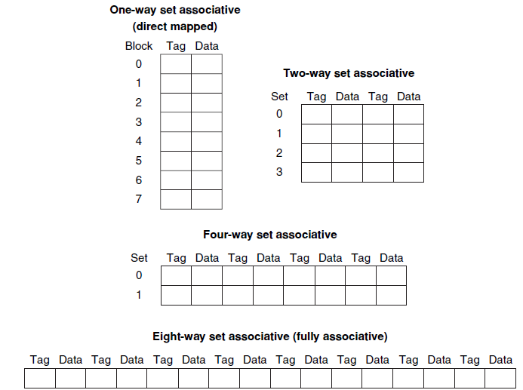
Set associative cache
We can also think of all block placement strategies as a variation on set associativity.

Slide 12
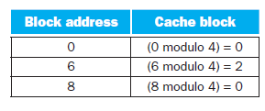
Misses and Associativity in Caches
Example:
Assume there are three small caches, each consisting of four one-word blocks. One cache is fully associative, a second is two-way set-associative, and the third is direct-mapped. Find the number of misses for each cache organization given the following sequence of block addresses: 0, 8, 0, 6, and 8.
Direct Mapped Cache: Let’s determine to which cache block each block address maps:

Slide 13
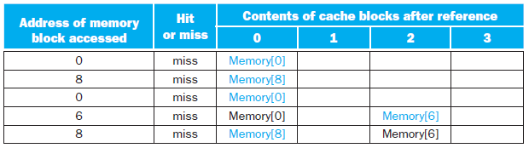
Cont.
Now we can fill in the cache contents after each reference, using a blank entry to mean that the block is invalid, coloured text to show a new entry added to the cache for the associated reference, and plain text to show an old entry in the cache:
The direct-mapped cache generates five misses for the five accesses.

Slide 14
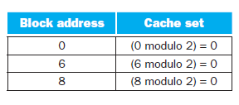
Cont.
Set-associative cache: The set-associative cache has two sets (with indices 0 and 1) with two elements per set. Let’s first determine to which set each block address maps:

Slide 15
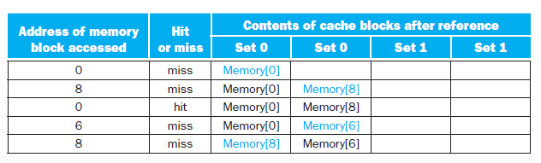
Cont.
Because we have a choice of which entry in a set to replace on a miss, we need a replacement rule. Set-associative caches usually replace the least recently used block within a set; that is, the block that was used furthest in the past is replaced. Using this replacement rule, the contents of the set-associative cache after each reference looks like this:
The two-way set-associative cache has four misses, one less than the direct-mapped cache.

Slide 16
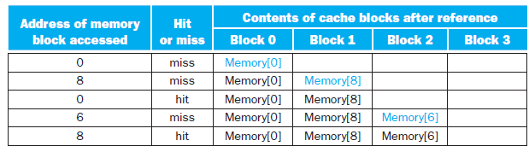
Cont.
Fully associative cache: The fully associative cache has four cache blocks (in a single set); any memory block can be stored in any cache block.
The fully associative cache has the best performance, with only three misses.

